Slide 1
Yarowsky’s Algorithm for word sense disambiguation
By. Nauman Alam 21108113

Slide 2
What is Word Sense Disambiguation?
The process of identifying the intended meaning of a word in a given context.
It is a fundamental task in natural language processing, as words can have multiple meanings depending on the context in which they are used.
This algorithm leverages contextual clues and statistical relationships to determine the most appropriate sense of a word.

Slide 3
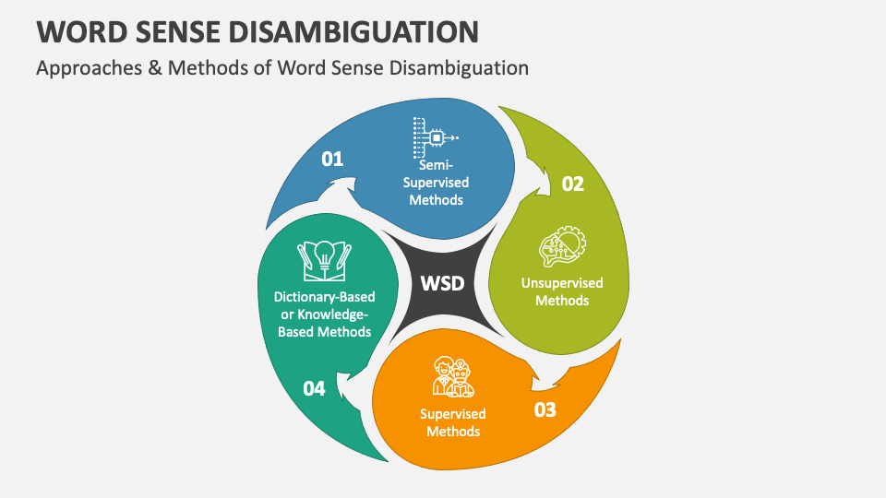

Slide 4



The Need for Yarowskis Algorithm
Ambiguous Words
Contextual Clues
Machine Learning
Many common words have multiple meanings, leading to ambiguity in language. Resolving this ambiguity is crucial for accurate natural language processing.
The meaning of an ambiguous word is often determined by the surrounding context. Yarowskis algorithm leverages these contextual clues to infer the correct word sense.
Yarowskis algorithm uses a statistical, machine learning-based approach to word sense disambiguation. This allows it to be more robust and accurate than rule-based methods.

Slide 5
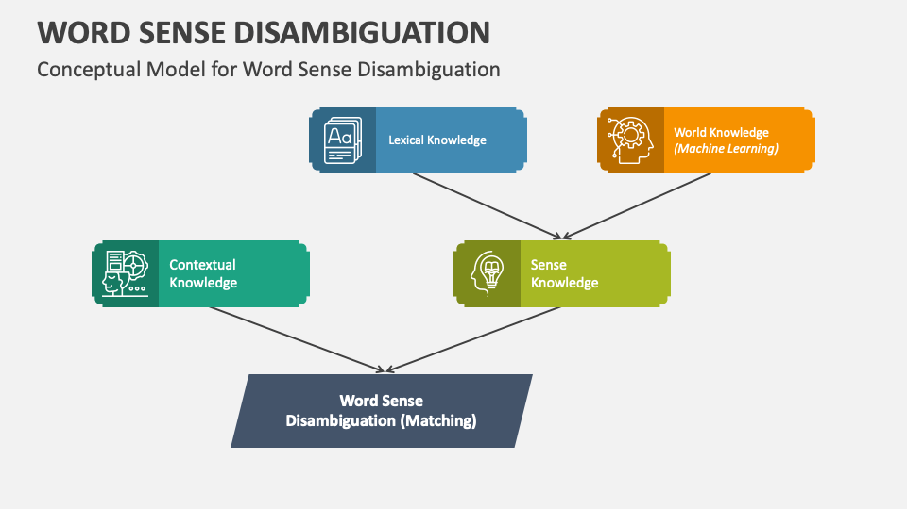

Slide 6
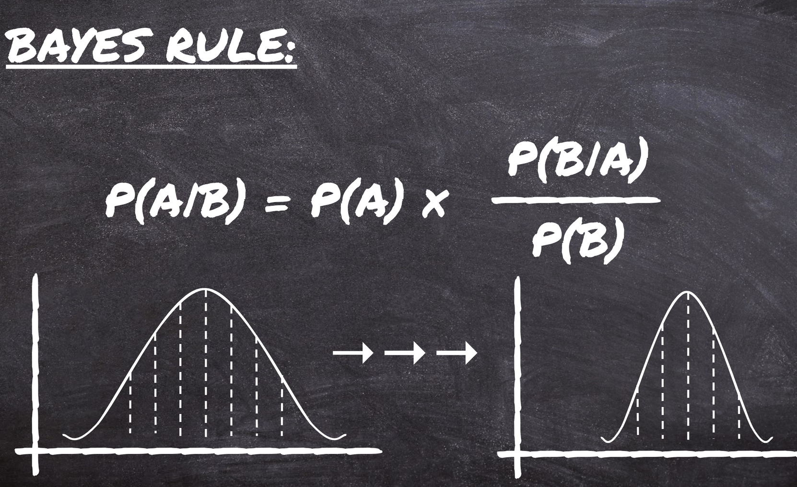
The Mathematics Behind Yarowskis Algorithm
Yarowskis algorithm is grounded in Bayesian probability theory, which allows it to leverage contextual clues to determine the most likely word sense. The algorithm calculates the conditional probability of each possible word sense given the surrounding context, and then selects the sense with the highest probability.
At the core of the algorithm is the idea that the probability of a word sense depends on the probability of the context occurring with that sense. By analyzing a large corpus of text, the algorithm can build up statistical models of how different word senses are used in different contexts.

Slide 7

Probability Distributions in Yarowskis Algorithm
Yarowskis algorithm for word sense disambiguation relies on the use of probability distributions to capture the likelihood of a word having a particular meaning given its context. The key probability distributions used are:
P(sense|word)
P(word|sense)
P(context|sense)
These probability distributions are estimated from large corpora of text data and are a crucial component of the Bayesian inference process used by Yarowskis algorithm to determine the most likely sense of an ambiguous word.

Slide 8

Bayesian Inference in Yarowskis Algorithm
Bayes' Theorem
1
Yarowskis algorithm relies on Bayes' Theorem, which provides a way to calculate the probability of a hypothesis given some observed evidence.
2
Likelihood and Prior Probabilities
The algorithm uses the likelihood of the observed context given a particular word sense, as well as the prior probabilities of each word sense.
Posterior Probability Calculation
3
By combining the likelihood and prior probabilities, Yarowskis algorithm calculates the posterior probability of each possible word sense, allowing it to select the most likely sense.

Slide 9
Contextual Clues and Yarowskis Algorithm
Leveraging Context
Semantic Relationships
Linguistic Cues
Yarowskis algorithm relies heavily on analyzing the surrounding context to determine the meaning of an ambiguous word. It looks at factors like nearby words, sentence structure, and topic to narrow down the possible senses.
The algorithm examines semantic relationships between words, such as synonyms, antonyms, and hyponyms, to better understand the intended meaning within the given context.
Grammatical elements like part of speech, verb tense, and word order provide important linguistic cues that help Yarowskis algorithm disambiguate the correct sense of a word.

Slide 10
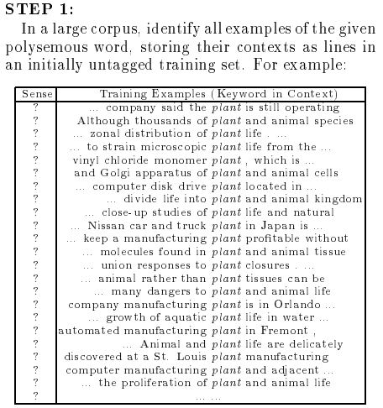
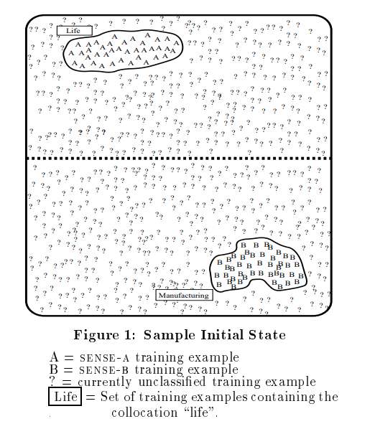

Slide 11
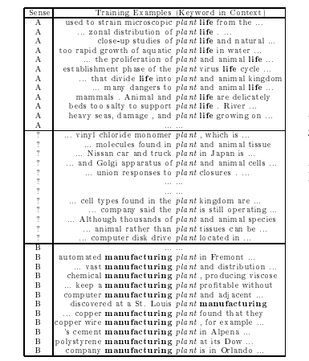
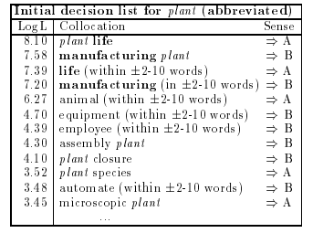

Slide 12
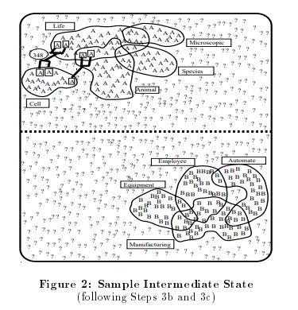
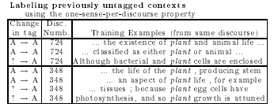


Slide 13
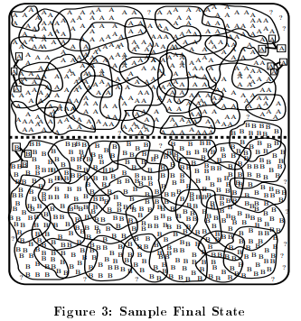
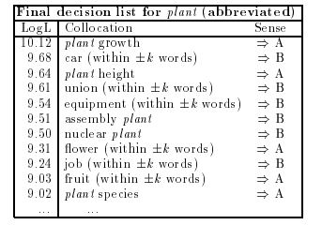

Slide 14
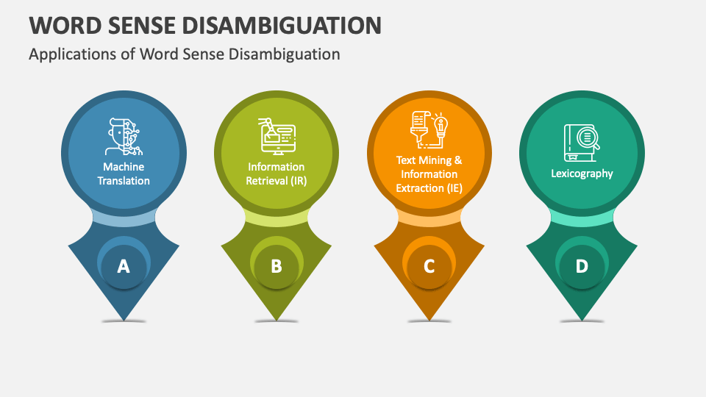
Effective WSD is critical for accurate language understanding and enables applications like machine translation, information retrieval, and sentiment analysis to work more effectively.

Slide 15



Example Application of Yarowskis Algorithm
Text Disambiguation
Word Sense Identification
Real-World Applications
Yarowskis algorithm can be used to disambiguate the meaning of a word in a given text context, helping natural language processing systems understand the intended meaning.
By analyzing the surrounding words and sentence structure, Yarowskis algorithm can accurately identify the specific sense or meaning of an ambiguous word in a document or conversation.
This algorithm has practical applications in areas like information retrieval, machine translation, and dialogue systems, where precise understanding of language is crucial.

Slide 16
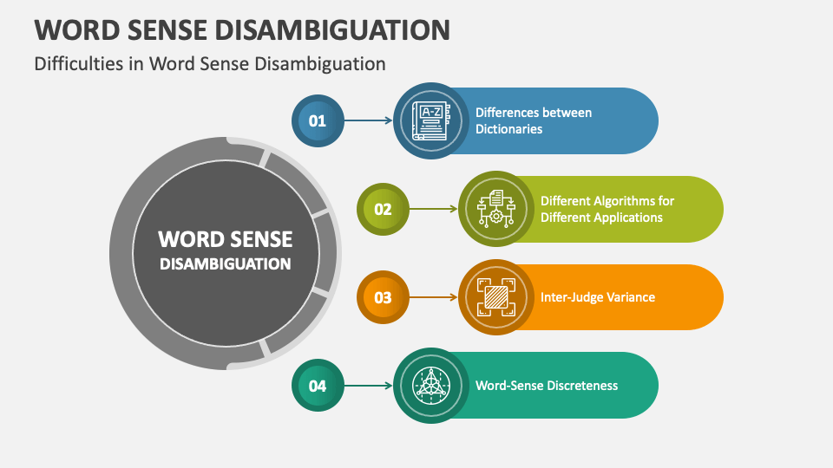

Slide 17
Limitations of Yarowskis Algorithm
1
Reliance on Contextual Clues
2
Corpus Dependence
Yarowskis algorithm heavily relies on the availability of strong contextual clues to disambiguate word senses. It may struggle in situations with limited contextual information.
The performance of Yarowskis algorithm is largely dependent on the quality and coverage of the training corpus used. Biases or inconsistencies in the corpus can negatively impact the algorithm's accuracy.
3
Inability to Handle Novel Senses
4
Assumption of Independent Features
The algorithm is limited in its ability to handle new or previously unseen word senses, as it is constrained by the knowledge in the training data.
Yarowskis algorithm assumes that the contextual features used for disambiguation are independent, which may not always be the case in natural language.

Slide 18
Paper 1: Word Sense Disambiguation and Information Retrieval
It has often been thought that word sense ambiguity is a cause of poor performance in Information Retrieval (IR) systems. The belief is that if ambiguous words can be correctly disambiguated, IR performance will increase. However, recent research into the application of a word sense disambiguator to an IR system failed to show any performance increase. From these results it has become clear that more basic research is needed to investigate the relationship between sense ambiguity, disambiguation, and IR.
Using a technique that introduces additional sense ambiguity into a collection, this paper presents research that goes beyond previous work in this field to reveal the influence that ambiguity and disambiguation have on a probabilistic IR system. We conclude that word sense ambiguity is only problematic to an B2 system when it is retrieving from very short queries. In addition we argue that if a word sense disambiguator is to be of any use to an IR system, the disambiguator must be able to resolve word senses to a high degree of accuracy.

Slide 19
Paper 2: Word sense disambiguation: a unified evaluation framework and empirical comparison
Word Sense Disambiguation is a longstanding task in Natural Language Processing, lying at the core of human language understanding. However, the evaluation of automatic systems has been problematic, mainly due to the lack of a reliable evaluation framework. In this paper we develop a unified evaluation framework and analyze the performance of various Word Sense Disambiguation systems in a fair setup.
The results show that supervised systems clearly outperform knowledge-based models. Among the supervised systems, a linear classifier trained on conventional local features still proves to be a hard baseline to beat. Nonetheless, recent approaches exploiting neural networks on unlabeled corpora achieve promising results, surpassing this hard baseline in most test sets.

Slide 20
Paper 3: Similarity-based Word Sense Disambiguation
We describe a method for automatic word sense disambiguation using a text corpus and a machine readable dictionary (MRD). The method is based on word similarity and context similarity measures. Words are considered similar if they appear in similar contexts; contexts are similar if they contain similar words.
The circularity of this definition is resolved by an iterative, converging process, in which the system learns from the corpus a set of typical usages for each of the senses of the polysemous word listed in the MRD. A new instance of a polysemous word is assigned the sense associated with the typical usage most similar to its context.
Experiments show that this method can learn even from very sparse training data, achieving over 92% correct disambiguation performance.

Slide 21
Paper 4: Trends in word sense disambiguation
The problem and process of identifying the meaning of a word as per its usage context is called word sense disambiguation (WSD). Although research in this field has been ongoing for the past forty years, a distinct change of techniques adopted can be observed over time. Two important parameters govern the direction in which WSD research progresses during any period.
These are the underlying requirement of the kind of sense disambiguation, or the domain, and the robustness of available knowledge in the form of corpora or dictionaries. This paper surveys the progress of WSD over time and the important linguistic achievements that enabled this progress.

Slide 22
Paper 5: Word-Sense Disambiguation Using Statistical Models of Roget's Categories Trained on Large Corpora
This paper describes a program that disambiguates English word senses in unrestricted text using statistical models of the major Roget's Thesaurus categories. Roget's categories serve as approximations of conceptual classes. The categories listed for a word in Roger's index tend to correspond to sense distinctions; thus selecting the most likely category provides a useful level of sense disambiguation. The selection of categories is accomplished by identifying and weighting words that are indicative of each category when seen in context, using a Bayesian theoretical framework.
Other statistical approaches have required special corpora or hand-labeled training examples for much of the lexicon. Our use of class models overcomes this knowledge acquisition bottleneck, enabling training on unrestricted monolingual text without human intervention. Applied to the 10 million word Grolier’s Encyclopedia, the system correctly disambiguated 92% of the instances of 12 polysemous words that have been previously studied in the literature.

Slide 23
References
Sanderson, Mark. "Word sense disambiguation and information retrieval." SIGIR’94: Proceedings of the Seventeenth Annual International ACM-SIGIR Conference on Research and Development in Information Retrieval, organised by Dublin City University. London: Springer London, 1994.
Raganato, Alessandro, Jose Camacho-Collados, and Roberto Navigli. "Word sense disambiguation: a uinified evaluation framework and empirical comparison." Proceedings of the 15th Conference of the European Chapter of the Association for Computational Linguistics: Volume 1, Long Papers. Vol. 1. 2017.
Vidhu Bhala, R. V., and S. Abirami. "Trends in word sense disambiguation." Artificial Intelligence Review 42 (2014): 159-171.
Agirre, Eneko, and Philip Edmonds, eds. Word sense disambiguation: Algorithms and applications. Vol. 33. Springer Science & Business Media, 2007.
Yarowsky, David. "Word-sense disambiguation using statistical models of Roget’s categories trained on large corpora." COLING 1992 Volume 2: The 14th International Conference on Computational Linguistics. 1992.

